Slide 1
What is new in VW 9
Cheng Tan, Microsoft Research
Zak Mhammedi, MIT
Mark Rucker, The University of Virginia
Eduardo Salinas, Microsoft Research
Alexey Taymanov, Microsoft Research

Slide 2
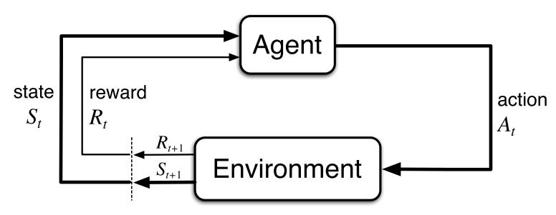

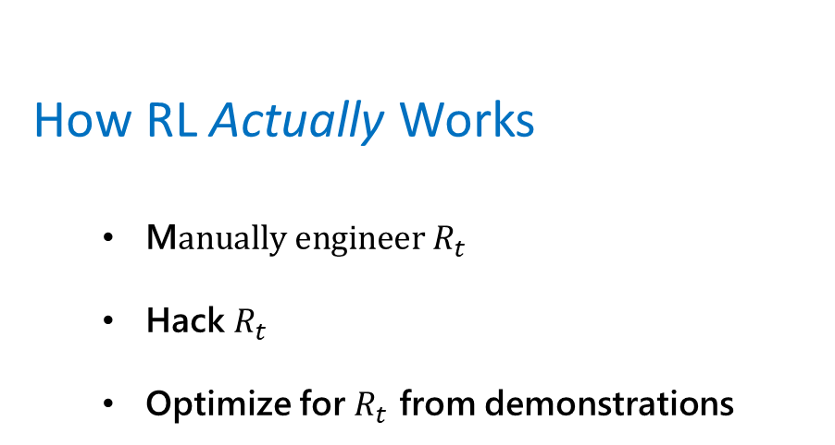
Interaction Grounded Learning (IGL) motivation
How RL Actually Works
M$anually engineer R_{t}$
Hack $R_{t}$
Optimize for $R_{t}$ from demonstrations
How RL Ought to Work
©Sutton, Richard S., and Andrew G. Barto. Reinforcement learning: An introduction. MIT press, 2018.
Policy learning via interaction
Sensory feedback $R_{t}$

Slide 3
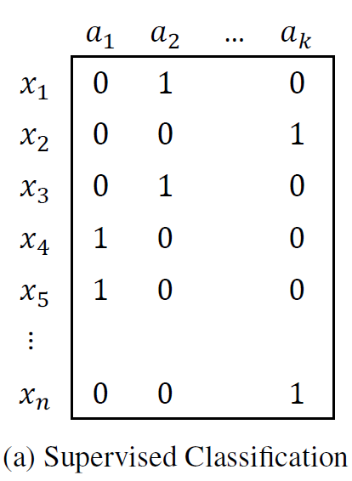
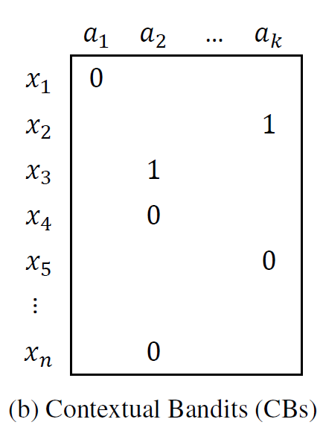
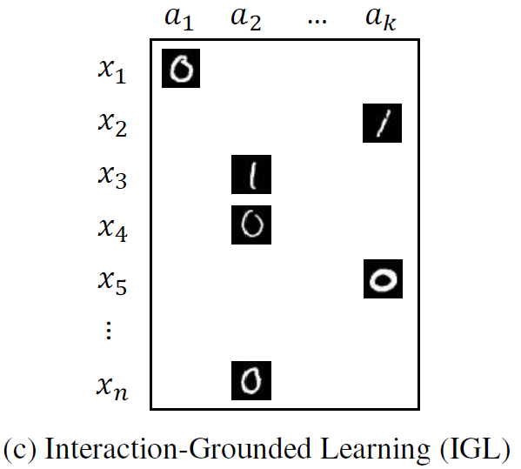
IGL
Reward information for
every context
Reward information for
chosen action
Feedback vector for chosen action
Xie, Tengyang, et al. "Interaction-Grounded Learning." arXiv preprint arXiv:2106.04887 (2021)
Notes:
- A learning paradigm where a learner optimize the latent rewards by interacting with the environment and associate the observed feedback with unobserved true reward
- It can leverage the implicit and explicit feedback signal and mitigate the need for reward engineering

Slide 4
IGL inside VowpalWabbit
Paper: https://arxiv.org/pdf/2106.04887.pdf
Learning with mis-specified reward
VW option: --igl (experimenal)
Expect CB format data
VW
Model 1
(learn with label as is)
Logged data
Action
Model 2
(learn with negated label)

Slide 5

FreeGrad
FreeGrad is a parameter-free algorithm for Online Convex Optimization (OCO)
Main use case in VW: contextual bandits
…via reduction to Online Supervised Learning/OCO
Using FreeGrad requires no parameter tuning

Slide 6
FreeGrad for Contextual Bandits in VW
CB reduction to Online Supervised Learning/OCO in VW:
VW
CB Master Algorithm
OCO subroutine
e.g. FreeGrad

Slide 7
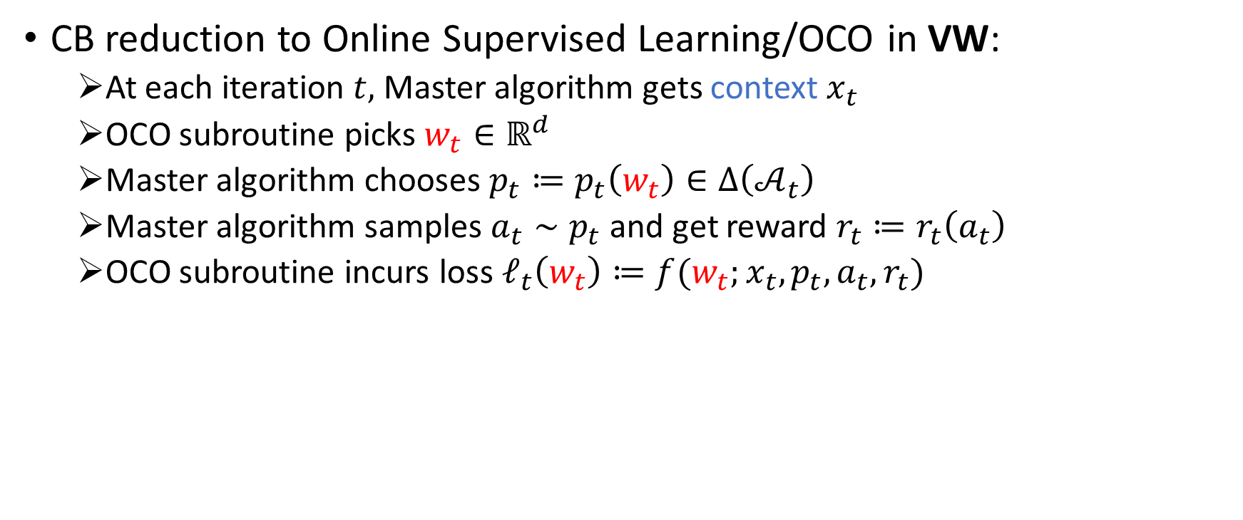
FreeGrad for Contextual Bandits in VW
CB reduction to Online Supervised Learning/OCO in VW:
At each iteration $t,$ Master algorithm gets context $x_{t}$
OCO subroutine picks $w_{t}∈ℝ^{d}$
Master algorithm chooses $p_{t}≔p_{t}\left(w_{t}\right)∈Δ\left(𝒜_{t}\right)$
Master algorithm samples $a_{t}∼p_{t}$and get reward $r_{t}≔r_{t}\left(a_{t}\right)$
OCO subroutine incurs loss $ℓ_{t}\left(w_{t}\right)≔f({w_{t};x}_{t},p_{t},a_{t},r_{t})$

Slide 8

FreeGrad for Contextual Bandits in VW
CB reduction to Online Supervised Learning/OCO in VW:
At each iteration $t,$ Master algorithm gets context $x_{t}$
OCO subroutine picks $w_{t}∈ℝ^{d}$
Master algorithm chooses $p_{t}≔p_{t}\left(w_{t}\right)∈Δ\left(𝒜_{t}\right)$
Master algorithm samples $a_{t}∼p_{t}$and get reward $r_{t}≔r_{t}\left(a_{t}\right)$
OCO subroutine incurs loss $ℓ_{t}\left(w_{t}\right)≔f({w_{t};x}_{t},p_{t},a_{t},r_{t})$
$w↦ℓ_{t}(w)$ convex

Slide 9
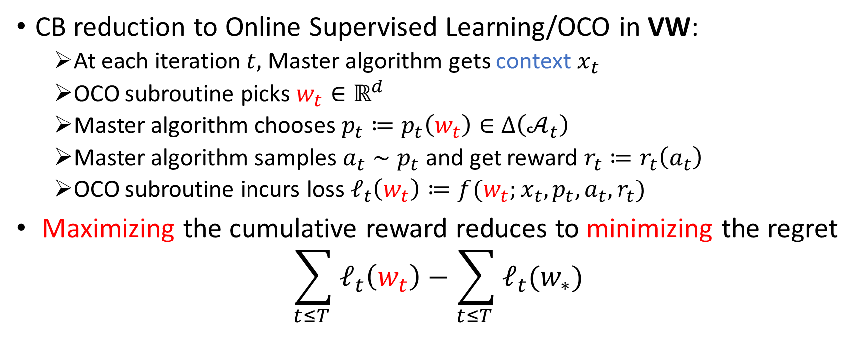
FreeGrad for Contextual Bandits in VW
CB reduction to Online Supervised Learning/OCO in VW:
At each iteration $t,$ Master algorithm gets context $x_{t}$
OCO subroutine picks $w_{t}∈ℝ^{d}$
Master algorithm chooses $p_{t}≔p_{t}\left(w_{t}\right)∈Δ\left(𝒜_{t}\right)$
Master algorithm samples $a_{t}∼p_{t}$and get reward $r_{t}≔r_{t}\left(a_{t}\right)$
OCO subroutine incurs loss $ℓ_{t}\left(w_{t}\right)≔f({w_{t};x}_{t},p_{t},a_{t},r_{t})$
Maximizing the cumulative reward reduces to minimizing the regret
$$\sum_{t≤T }{ℓ_{t}\left(w_{t}\right)−\sum_{t≤T }{ℓ_{t}(w_{∗})}}$$

Slide 10
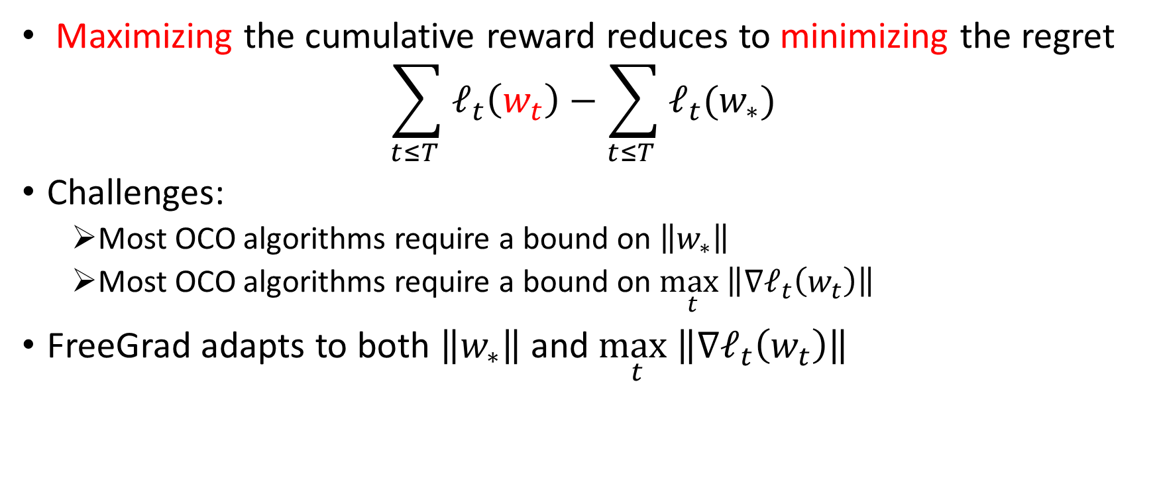

FreeGrad for Contextual Bandits in VW
Maximizing the cumulative reward reduces to minimizing the regret
$$\sum_{t≤T }{ℓ_{t}\left(w_{t}\right)−\sum_{t≤T }{ℓ_{t}(w_{∗})}}$$
Challenges:
Most OCO algorithms require a bound on $\left\|w_{∗}\right\|$
Most OCO algorithms require a bound on $\max_{t}\left\|∇ℓ_{t}\left(w_{t}\right)\right\|$
FreeGrad adapts to both $\left\|w_{∗}\right\|$ and $\max_{t}\left\|∇ℓ_{t}\left(w_{t}\right)\right\|$
Adapting to both is very challenging
$$w_{∗}∈ℝ^{d}$$

Slide 11
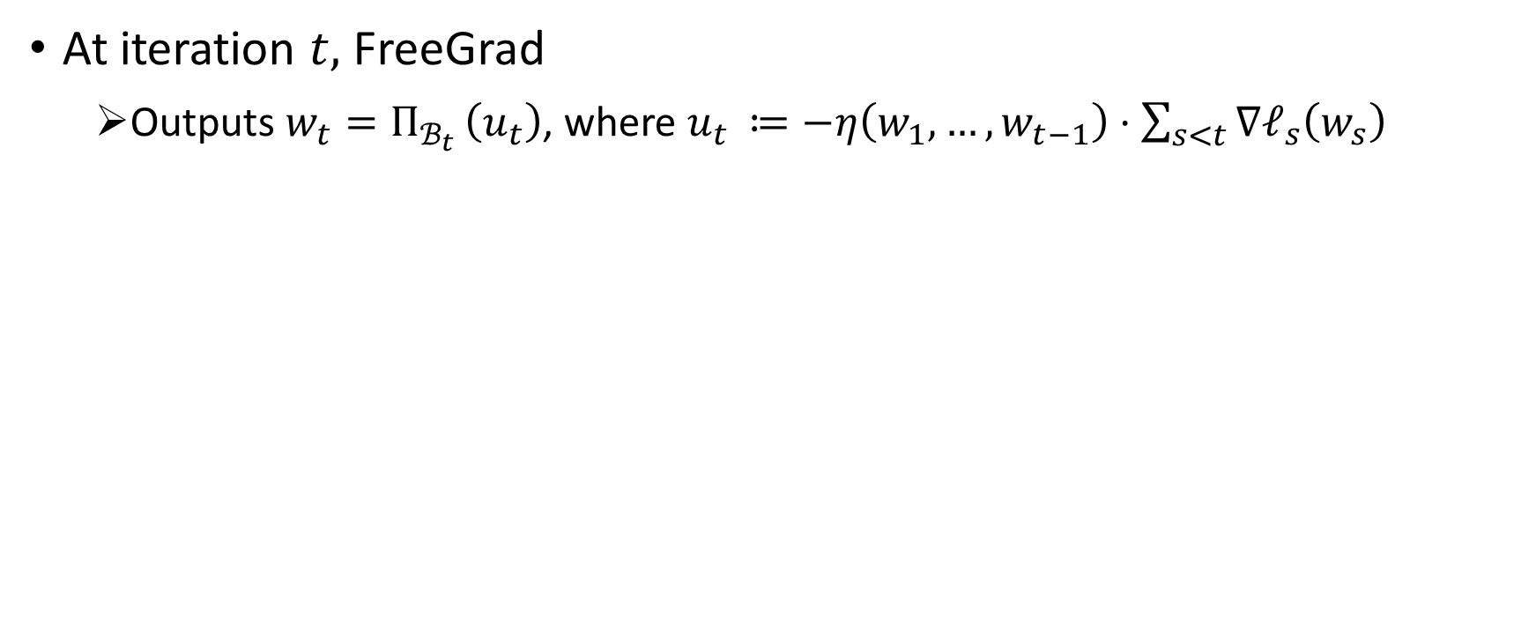
FreeGrad: Algorithm Details
At iteration $t,$ FreeGrad
Outputs $w_{t}=Π_{ℬ_{t} }\left(u_{t}\right)$, where $u_{t }≔−η\left(w_{1},…,w_{t−1}\right)⋅\sum_{s<t}{∇ℓ_{s}\left(w_{s}\right)}$

Slide 12
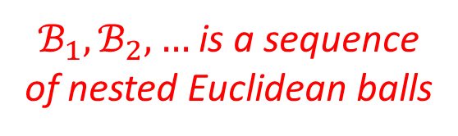
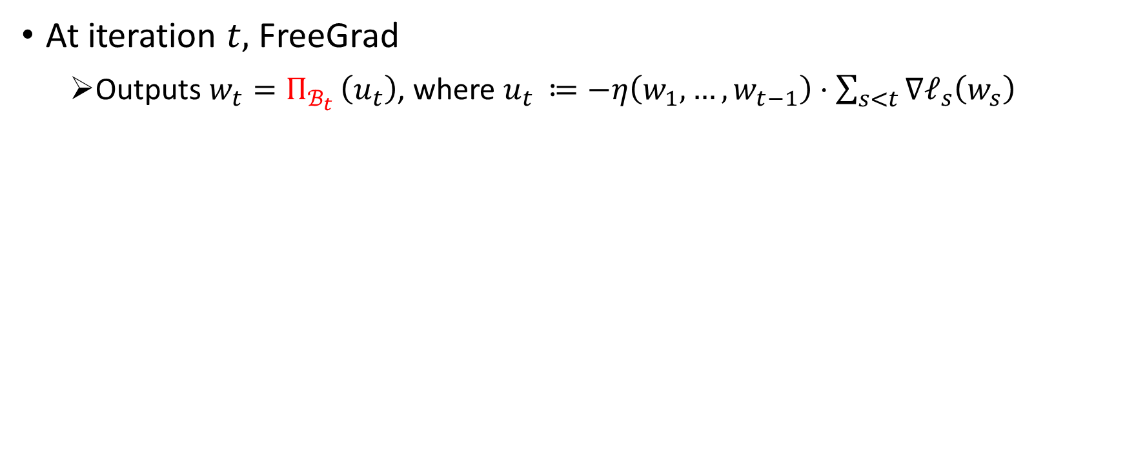
FreeGrad: Algorithm Details
At iteration $t,$ FreeGrad
Outputs $w_{t}=Π_{ℬ_{t} }\left(u_{t}\right)$, where $u_{t }≔−η\left(w_{1},…,w_{t−1}\right)⋅\sum_{s<t}{∇ℓ_{s}\left(w_{s}\right)}$
$ℬ_{1}, ℬ_{2},…$ is a sequence of nested Euclidean balls

Slide 13
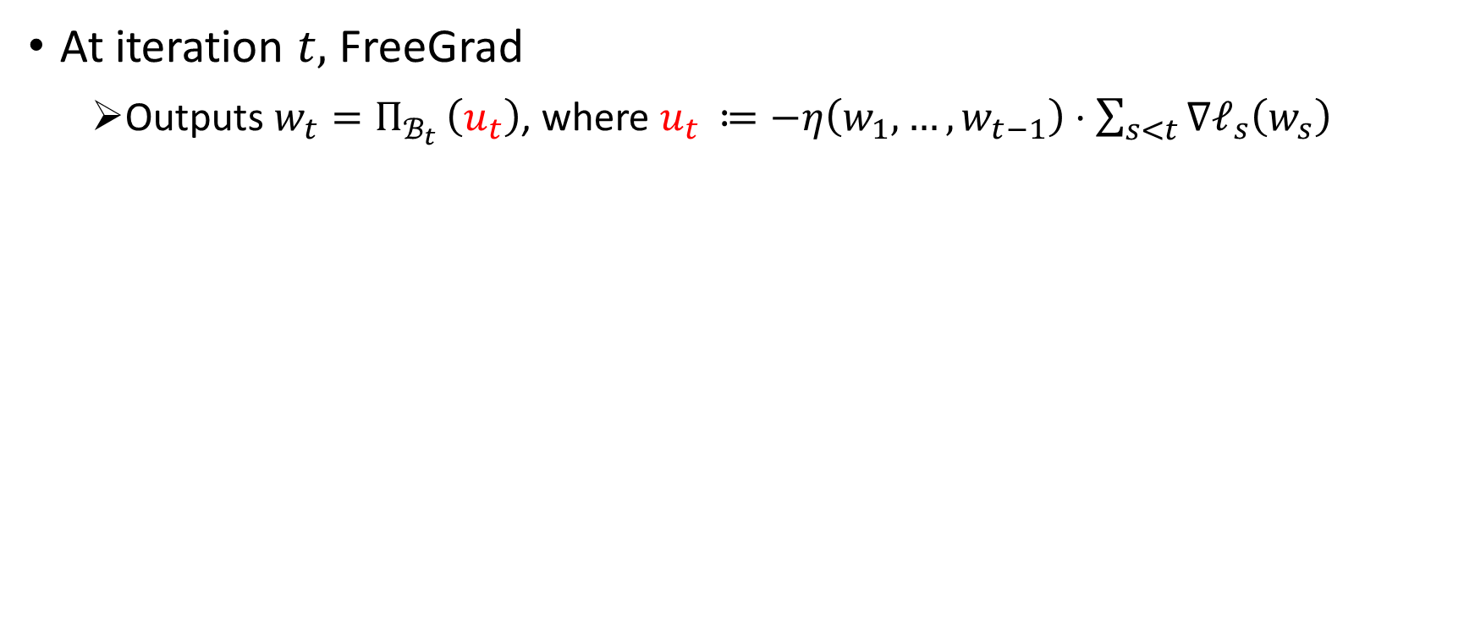
FreeGrad: Algorithm Details
At iteration $t,$ FreeGrad
Outputs $w_{t}=Π_{ℬ_{t} }\left(u_{t}\right)$, where $u_{t }≔−η\left(w_{1},…,w_{t−1}\right)⋅\sum_{s<t}{∇ℓ_{s}\left(w_{s}\right)}$

Slide 14
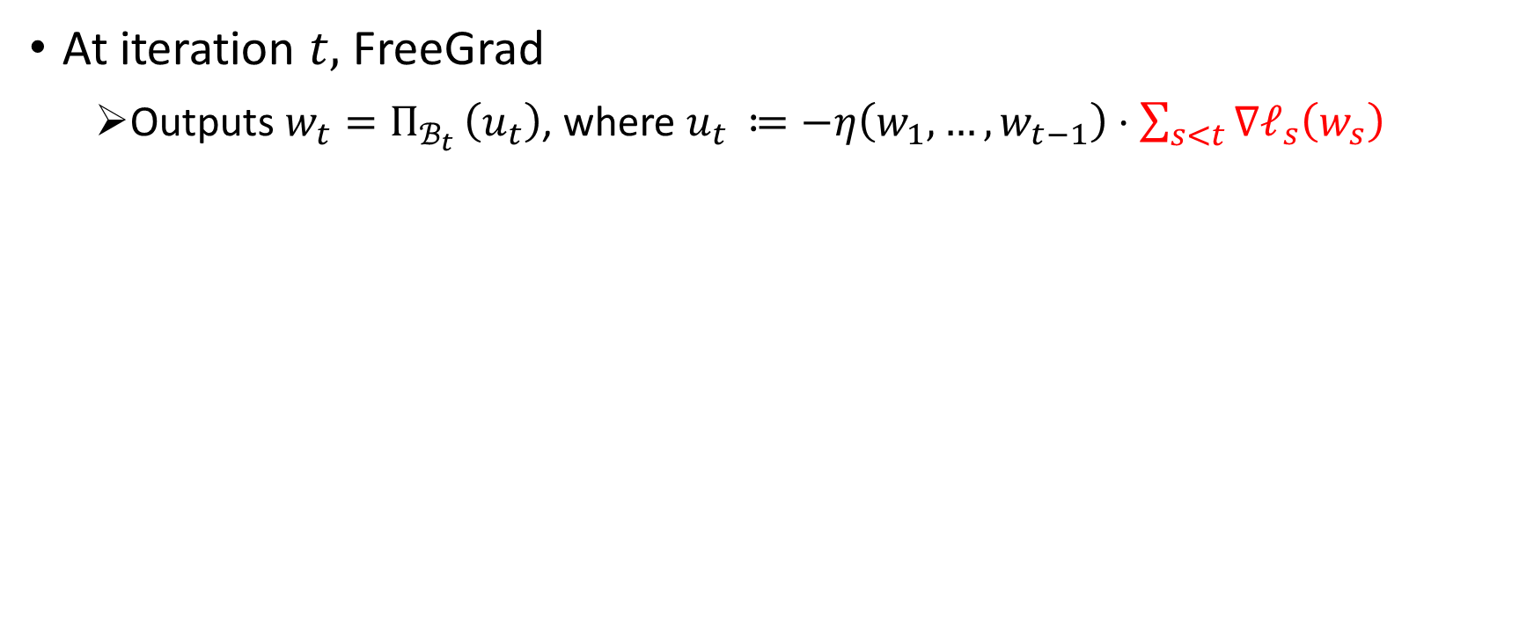
FreeGrad: Algorithm Details
At iteration $t,$ FreeGrad
Outputs $w_{t}=Π_{ℬ_{t} }\left(u_{t}\right)$, where $u_{t }≔−η\left(w_{1},…,w_{t−1}\right)⋅\sum_{s<t}{∇ℓ_{s}\left(w_{s}\right)}$

Slide 15
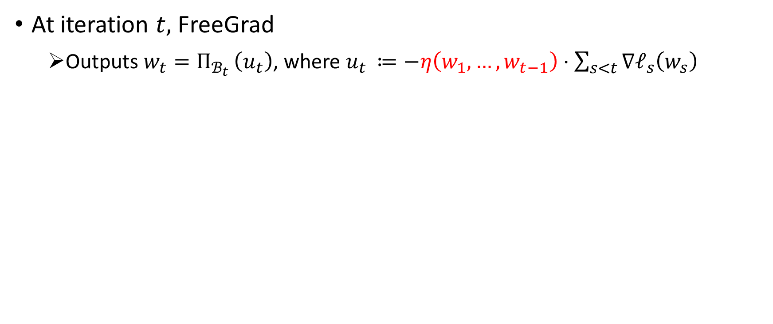
FreeGrad: Algorithm Details
At iteration $t,$ FreeGrad
Outputs $w_{t}=Π_{ℬ_{t} }\left(u_{t}\right)$, where $u_{t }≔−η\left(w_{1},…,w_{t−1}\right)⋅\sum_{s<t}{∇ℓ_{s}\left(w_{s}\right)}$

Slide 16
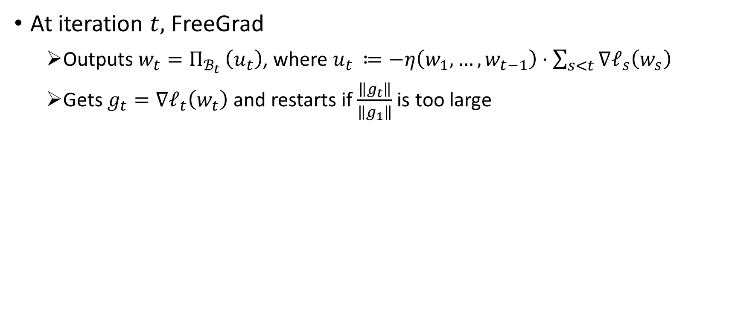
FreeGrad: Algorithm Details
At iteration $t,$ FreeGrad
Outputs $w_{t}=Π_{ℬ_{t} }\left(u_{t}\right)$, where $u_{t }≔−η\left(w_{1},…,w_{t−1}\right)⋅\sum_{s<t}{∇ℓ_{s}\left(w_{s}\right)}$
Gets $g_{t}=∇ℓ_{t}\left(w_{t}\right)$ and restarts if $\frac{\left\|g_{t}\right\|}{\left\|g_{1}\right\|}$ is too large

Slide 17
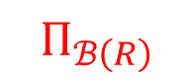
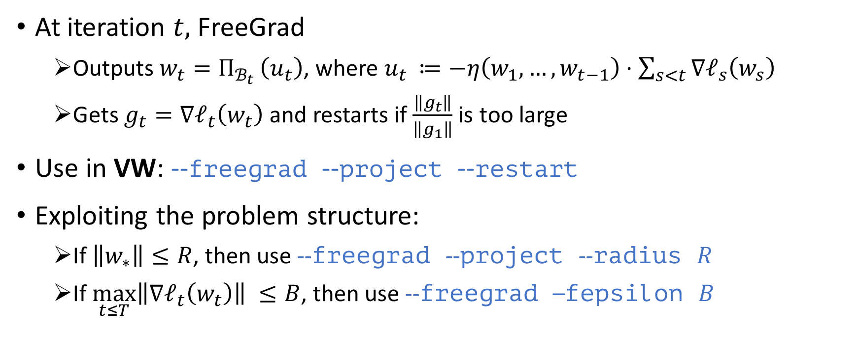
FreeGrad: Algorithm Details
At iteration $t,$ FreeGrad
Outputs $w_{t}=Π_{ℬ_{t} }\left(u_{t}\right)$, where $u_{t }≔−η\left(w_{1},…,w_{t−1}\right)⋅\sum_{s<t}{∇ℓ_{s}\left(w_{s}\right)}$
Gets $g_{t}=∇ℓ_{t}\left(w_{t}\right)$ and restarts if $\frac{\left\|g_{t}\right\|}{\left\|g_{1}\right\|}$ is too large
Use in VW: --freegrad --project --restart
Exploiting the problem structure:
If $\left\|w_{∗}\right\|≤R$, then use --freegrad --project --radius $R$
If$\max_{t≤T}\left\|∇ℓ_{t}\left(w_{t}\right)\right\| ≤B$, then use --freegrad –fepsilon $B$
$$Π_{ℬ\left(R\right)}$$

Slide 18
FreeGrad
Link to FreeGrad paper https://arxiv.org/pdf/2002.12242.pdf
VW reduction on GitHub:
vowpal_wabbit/vowpalwabbit/core/src/reductions/freegrad.cc

Slide 19
Python speedup
In the latest version of VW (9.2.0) pyvw is faster than ever...
We achieve this by optimizing how data is passed to pyvw
object
package
pyvw
Time loss 1
Time loss 2

Slide 20
Python speedup
A new way to package data before sending to pyvw
object
package
pyvw
string
tuples
dict

Slide 21
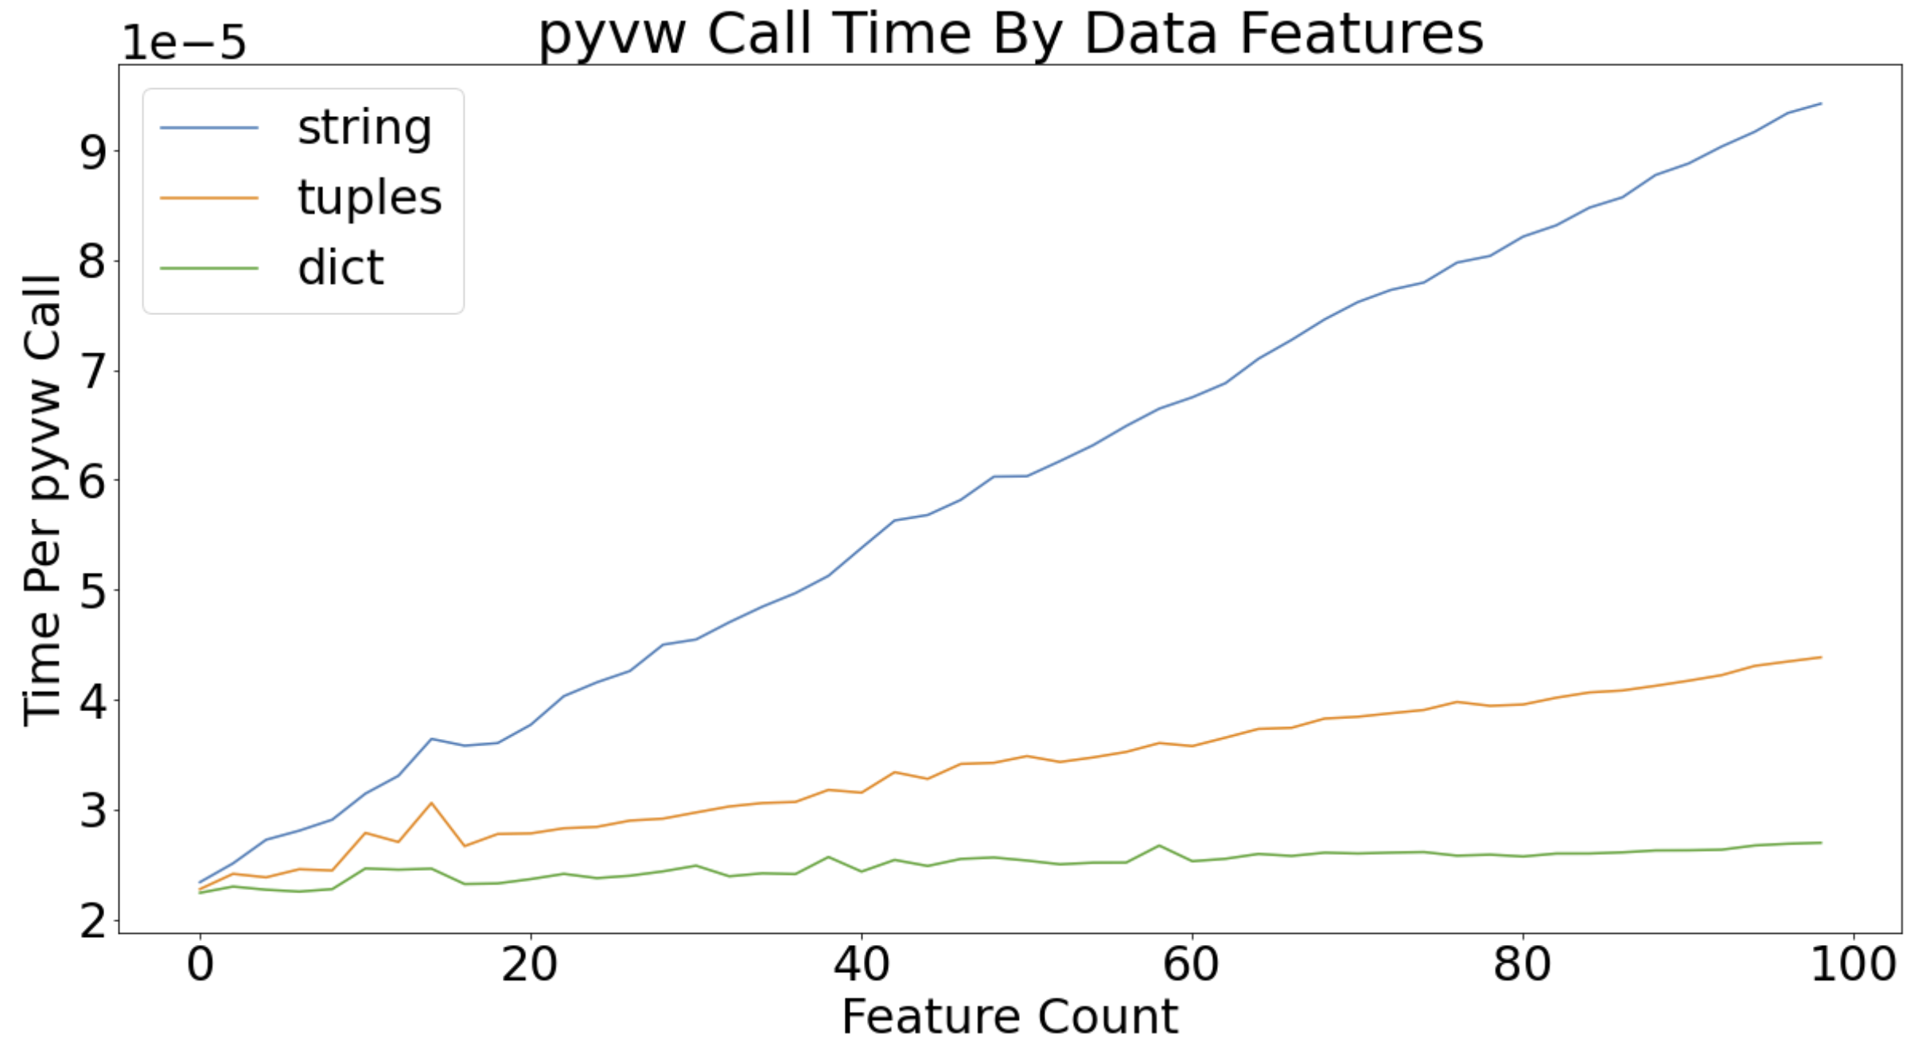
Python speedup

Slide 22
Python speedup
Can this speed up my pyvw code?
Is your data already in VW string format?
Does your data have a lot of features?
Are you making many calls to pyvw?
e.g., 1 million calls with 100 features could give a 60 second time save

Slide 23
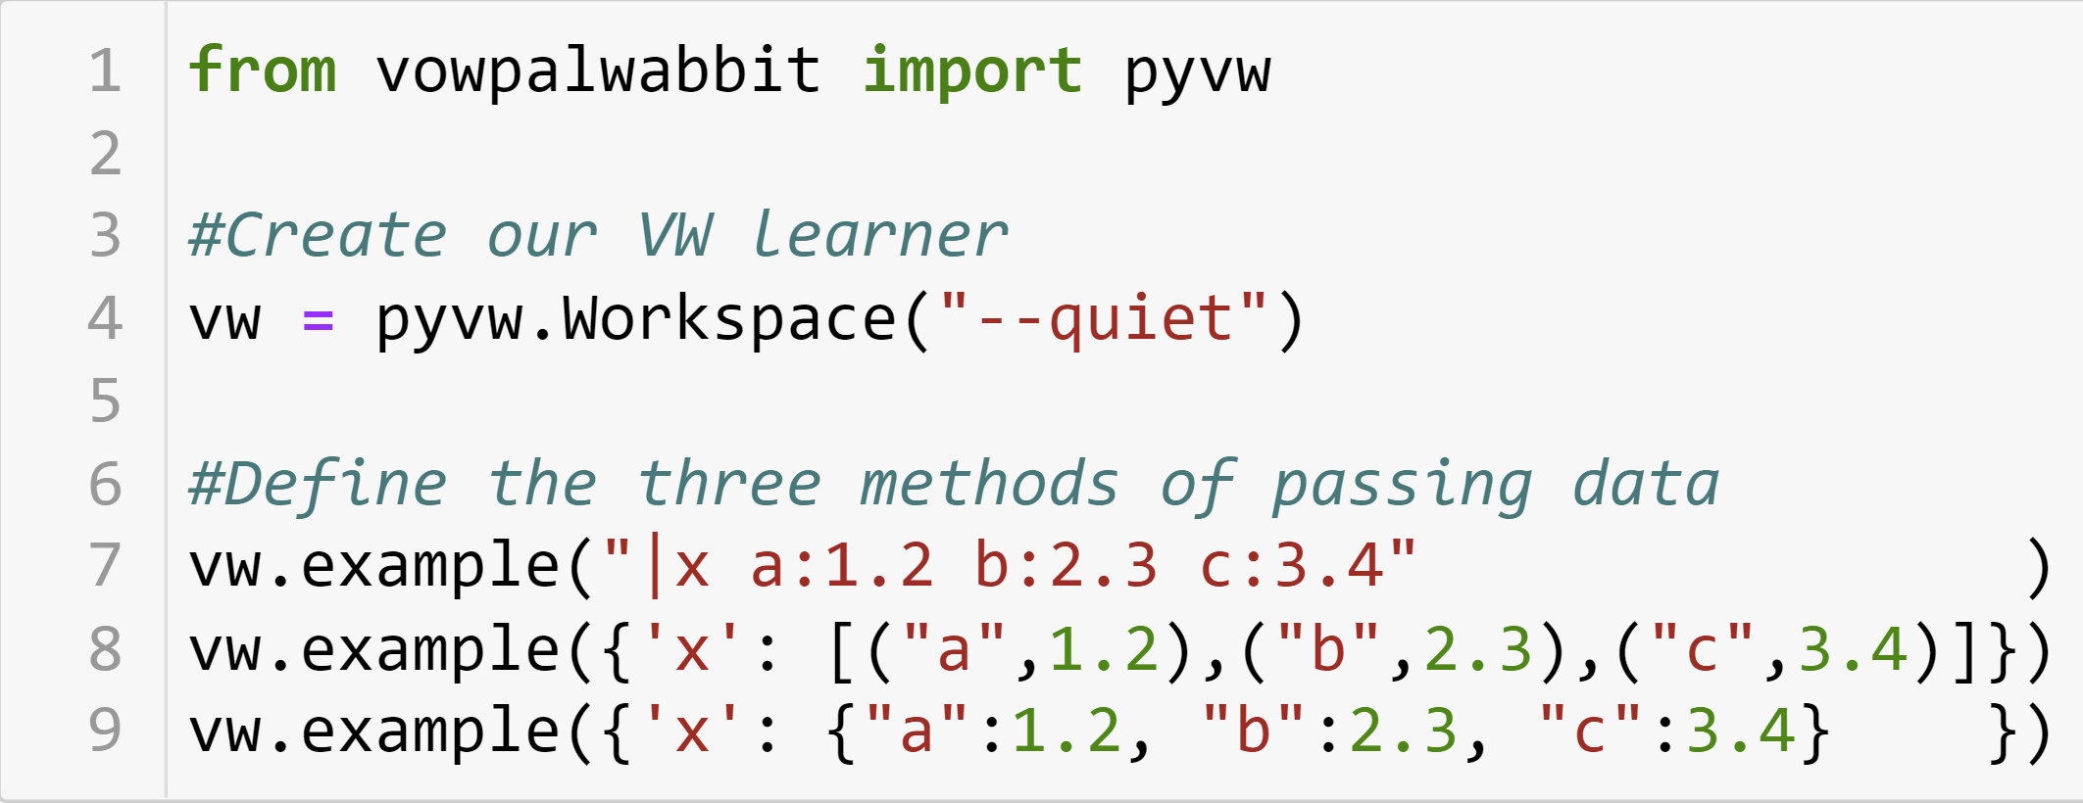
Python speedup
string
tuples
dict

Slide 24
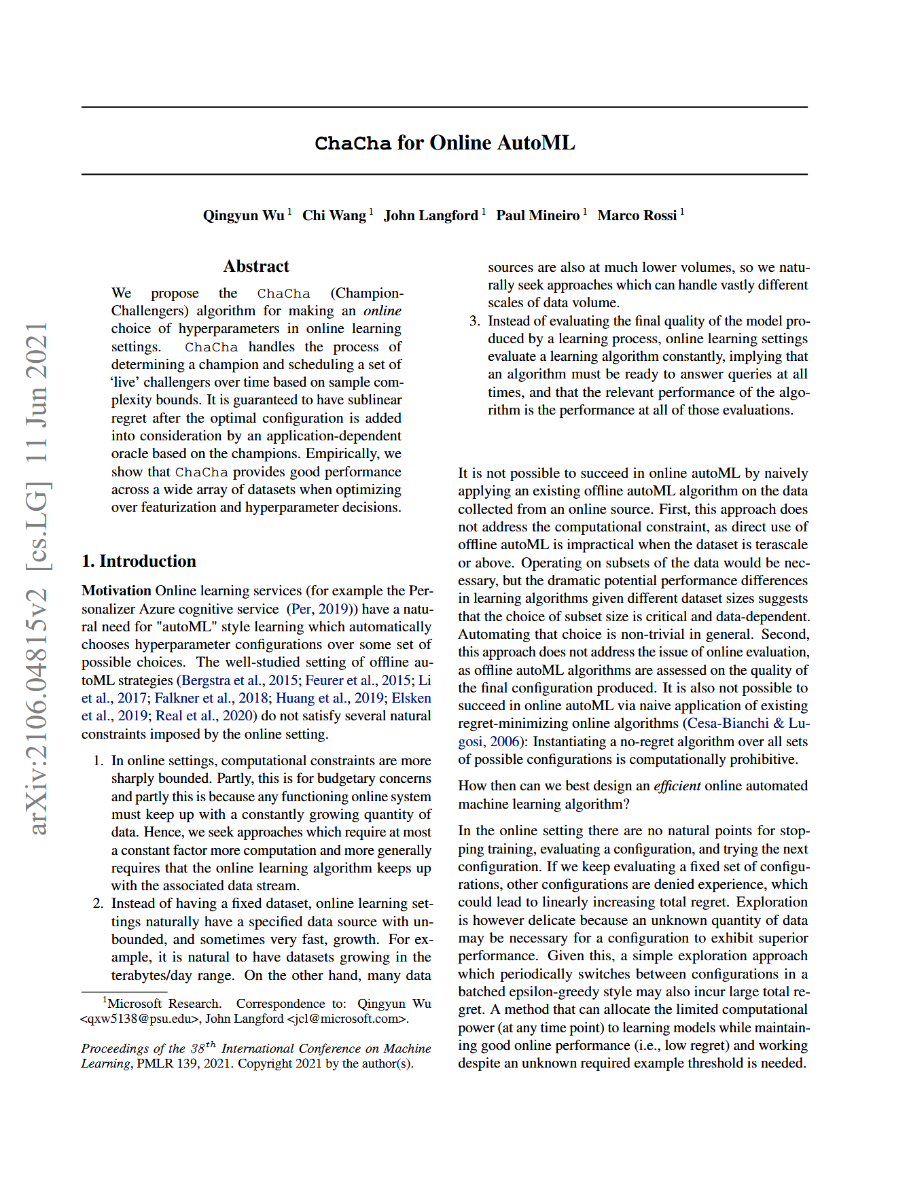
Inspiration
Notes:
https://arxiv.org/pdf/2106.04815.pdf
Presented at ICML 2021
This paper was worked on by the NY MSR lab,
With Qingyun a postdoc that worked with us this year,
John Langford and our data scientist Paul and Marco
Don’t have to introduce

Slide 25
Online AutoML in VW
Vowpal Wabbit
4 live slots:
N alternate configs:
Champ config
B+
Config #112
Config #104
Config #105
F
Config #107
Predict
Call
Learnable
Event
Config #106
Config #103
B-
Config #096
Config #097
Config #093
C+
Config Oracle
Notes:
---
Make sure to introduce the scoring concept, before going deep
In this diagram we have 4 slots, this is the total max configs we can ‘play’ or test out at any given moment.
DRIVE point of why 4 -> primary concern with testing configurations online is the computation overhead of evaluating all of them. We are not doing this, we have a fixet set of slots and then we rotate the configs, and then we avoid starving a particular config. Balancing here is the tricky research problem….
Live slots have a concept of scoring, in this diagram it has been simplified to the letter grading.
We have some pending challenger or alternate configs (these configs are generated by what we call Config Oracle)
It is agnostic to personalizer or the current infra, this change is behind the vowpal wabbit curtain, no need for the customer to change anything or for us to modify the infrastructure
---
talk about, we use off policy sequences to decide wether one config is better than the other one
too much detail the lower bound
we cant comapre the empirical performance of the champ and challengere
off policy sequence, that the difference is positive with high probability
its a statistical test, thats design to have a certain control false positive rate, thats design for contextual bandit
you want to avoid flukes, martingale test

Slide 26
What is a config?
Currently we only support mutating the interactions hyper-parameter. It starts with the greedy interaction ‘–q ::’ and starts removing or adding specific interactions.
If a dataset has the following feature namespaces:
TimeFeatures, GeoFeatures, FooFeatures, BarFeatures
-q :: -> { TG, TF, TB, TT, GF, GB, GG, FB, FF, BB }

Slide 27
Online AutoML – how to use
[Reduction] Automl Options:
--automl arg Set number of live configs (type: uint, default: 4, keep, necessary,
experimental)
--global_lease arg Set initial lease for automl interactions (type: uint, default:
4000, keep, experimental)
--priority_challengers arg Set number of priority challengers to use (type: int, default:
-1, keep, experimental)
--verbose_metrics Extended metrics for debugging (type: bool, experimental)
--automl_significance_level arg Set significance level for champion change (type: float, default:
0.05, keep, experimental)
Keep in mind:
Total size of dataset (or if its online)
Total amount of feature namespaces and size of interacting greedily
Amount of ‘lease’ to give to an alternative config (--global_lease arg)
AutoML is available for cb_adf and cb_explore_adf

Slide 28
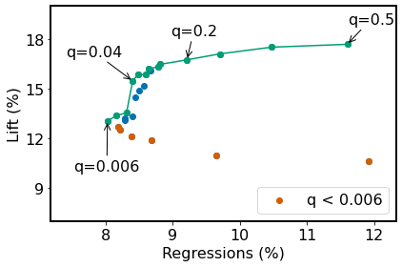
Expectile Loss. Motivation
Intuition: Sacrifice minor average lift to avoid worst-case outcomes
Risk Averse
Risk Neutral
important
crucial

Slide 29
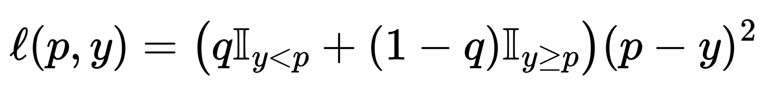
Expectile Loss
Asymmetric squared loss, with q in (0, 0.5]
Encourage overprediction -> “Risk-averse”
prediction
label
low penalty for
over-prediction
high penalty for
under-prediction
squared loss
Loss functions · VowpalWabbit/vowpal_wabbit Wiki (github.com)

Slide 30
Expectile loss. How to use
Example Options:
--loss_function arg Specify the loss function to be used, uses squared by default
(type: str, default: squared, choices {classic, expectile, hinge,
logistic, poisson, quantile, squared})
--expectile_q arg Parameter q associated with Expectile loss (required). Must be
a value in (0.0, 0.5]. (type: float)

Slide 31
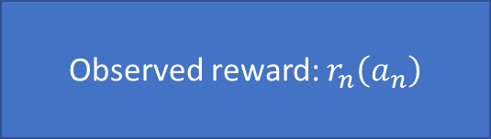
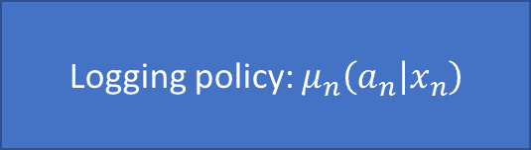
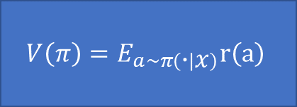
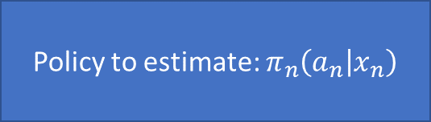
Counterfactual Estimation using Estimators library
Logging policy: $μ_{n}\left(a_{n} | x_{n}\right)$
Observed reward: $r_{n}\left(a_{n}\right)$
Estimator
$$V\left(π\right)=E_{a\sim π\left(∙ | x\right)}r\left(a\right)$$
Policy to estimate: $π_{n}\left(a_{n} | x_{n}\right)$

Slide 32
Estimators library
Code repository: VowpalWabbit/estimators: Estimators to perform off-policy evaluation (github.com)
How to use:

Slide 33

Estimators. What are decisions
A
A
A
?
B
B
B
?
C
C
D
?
D
Bandits
Slates
A
C
?
B
A
C
?
CCB

Slide 34
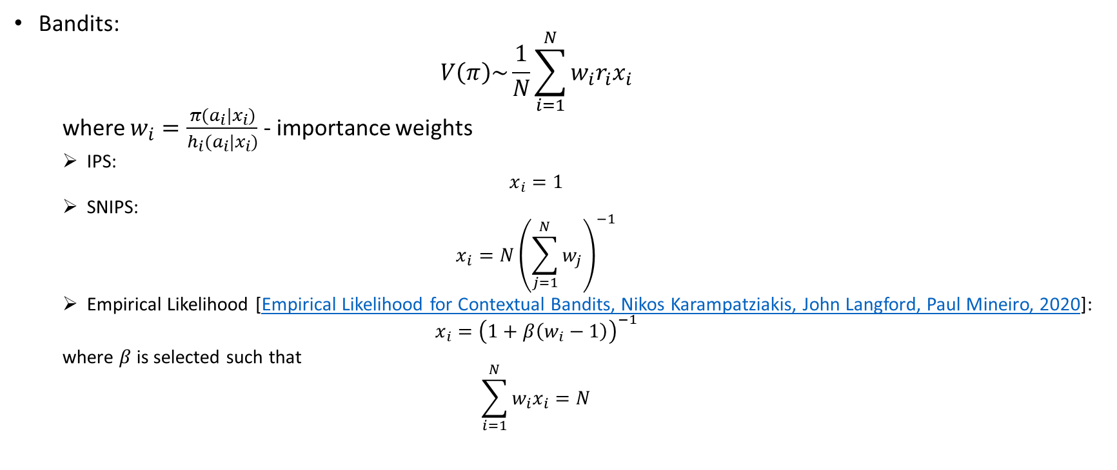
Estimators. Implementations.
Bandits:
$$V\left(π\right)\sim \frac{1}{N}\sum_{i=1}^{N}{w_{i}r_{i}x_{i}}$$
where $w_{i}=\frac{π(a_{i}|x_{i})}{h_{i}(a_{i}|x_{i})}$ - importance weights
IPS:
$$x_{i}=1$$
SNIPS:
$$x_{i}=N{\left(\sum_{j=1}^{N}{w_{j}}\right)}^{−1}$$
Empirical Likelihood [Empirical Likelihood for Contextual Bandits, Nikos Karampatziakis, John Langford, Paul Mineiro, 2020]:
$$x_{i}={\left(1+β\left(w_{i}−1\right)\right)}^{−1}$$
where $β$ is selected such that
$$\sum_{i=1}^{N}{w_{i}x_{i}}=N$$

Slide 35
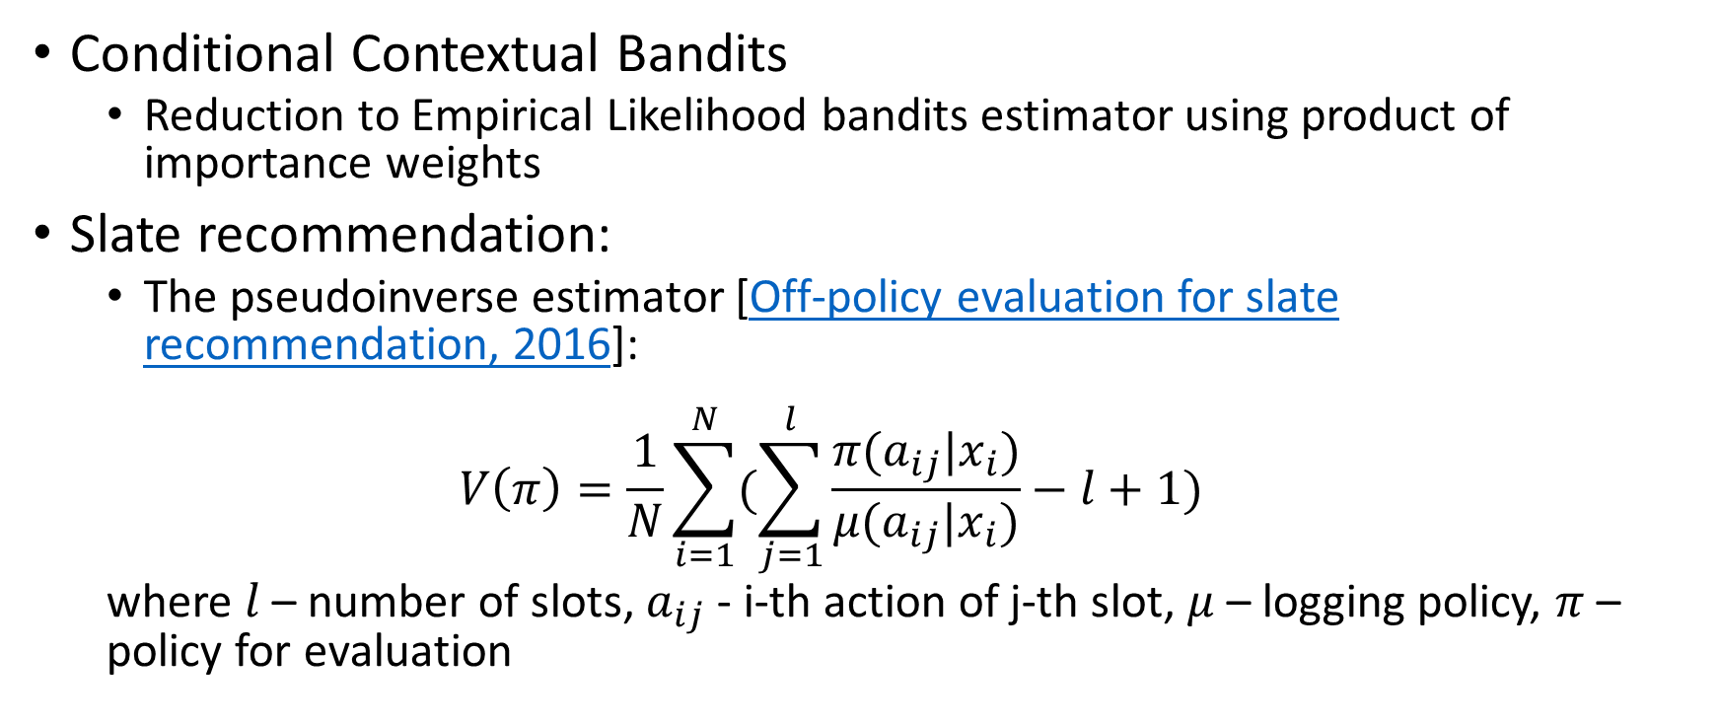
Estimators. Implementations
Conditional Contextual Bandits
Reduction to Empirical Likelihood bandits estimator using product of importance weights
Slate recommendation:
The pseudoinverse estimator [Off-policy evaluation for slate recommendation, 2016]:
$$V\left(π\right)=\frac{1}{N}\sum_{i=1}^{N}{(\sum_{j=1}^{l}{\frac{π(a_{ij}|x_{i})}{μ(a_{ij}|x_{i})}−l+1})}$$
where $l$ – number of slots, $a_{ij}$ - i-th action of j-th slot, $μ$ – logging policy, $π$ – policy for evaluation

Slide 36
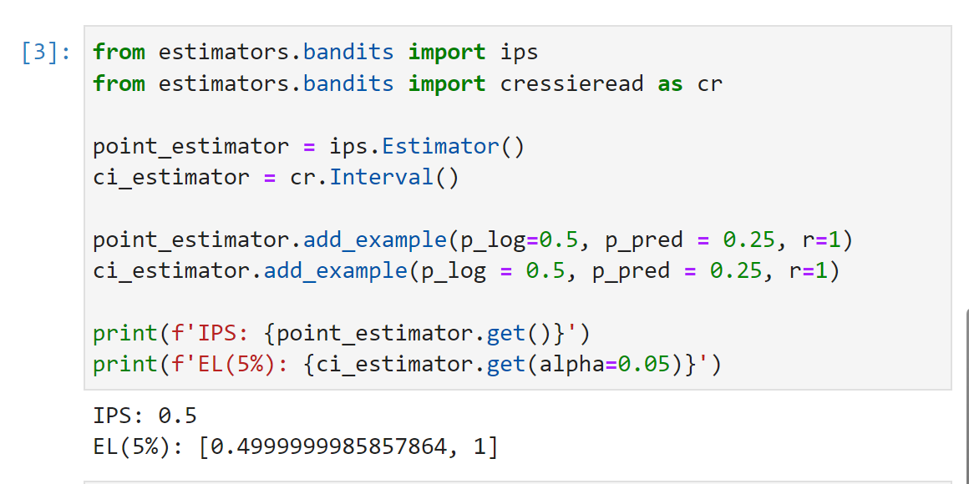
Estimators usage
Python code example
Point estimate
Confidence interval

Slide 37
Other improvements
Full namespaces interactions
Extra metrics
Model output in json format
Pyvw / df2vw improvements
…

